Slide 1

Football Score Prediction
FCEA Group 6
Billie, Luke, Rachmiel

Slide 2
Table of contents
01
02
03
04
Motivation
Data Analysis
Problem Definition
Motivation
Webscraping
Data Processing
Exploratory Data Analysis
Core Analysis
Conclusion
Aims
Model
Techniques
Outcome/Insights
Recommendations
Areas of Improvement

Slide 3
01
Motivation
Problem Definition
Motivation

Slide 4
Problem Definition
Predict season results (standings) in Europe’s top 5 domestic football leagues
Supervised learning
Prediction of Classes
Predict outcome of each match: {Win, Draw, Lose}
Overall league standings are determined by points: {W=3, D=1, L=0}

Slide 5
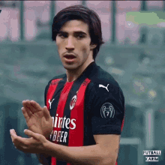
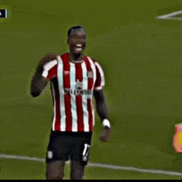
Practical Motivation
Football enthusiasts :)
Practical applications: sports betting
(Futball_Karim, 2022)
(balpino, 2021)

Slide 6
02
Data Analysis
Webscraping
Data Processing
Exploratory Data Analysis

Slide 7


Dataset
Data Acquisition
Webscraping
FBRef, FlashScore, Transfermarkt
Data type
Structured → Mixed
Categorical – team names, country
Numeric – performance-related statistics (e.g. possession, squad value)
Unstructured
Images – for decorating visualisations
(Hassan, 2023)
(Patil, 2023)
Notes:
HTML → Pandas dataframe

Slide 8
Dataset
Data Cleaning
Check for null/missing and duplicate values
Check for anomalies
Missing games
Using previous season data
Data Processing
Combining datasets (mapping)
Inferred data
Aggregated results + home-away split
Averaged (per-game) statistics
Form
Feature selection for ML
Notes:
Because of relegation and promotion, for promoted teams, Rachmiel had to pull data from the lower leagues, exclude playoff matches, and figure out which teams
Manipulated data to come up with some derived data of our own

Slide 9
EDA – Feature Selection
Use PPG as an aggregation of {W, D, L}
Criteria
Strength of correlation
Relevance – based on domain knowledge
Uniqueness
Overview
Goals Scored & Conceded
Squad Value
Possession
Notes:
Will look at how PPG relates to these trends and attempt to explain correlation with causal reasons based on my domain knowledge

Slide 10
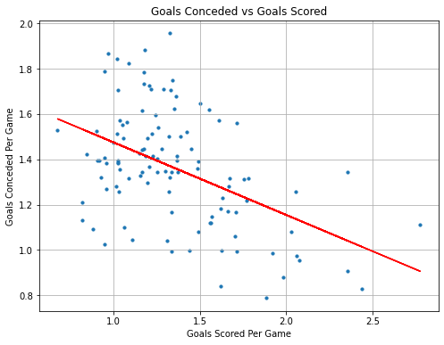
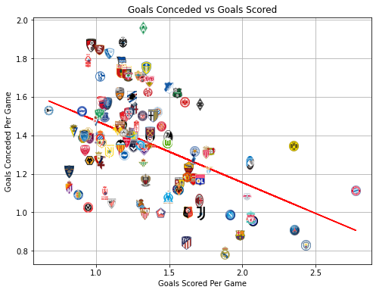
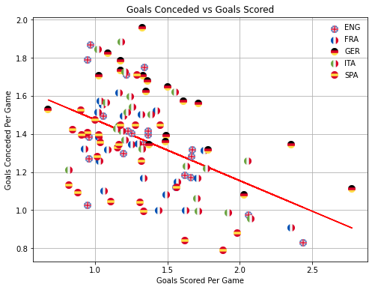
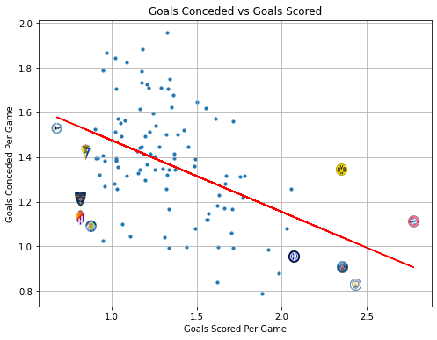
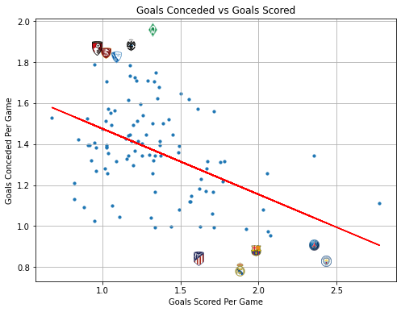
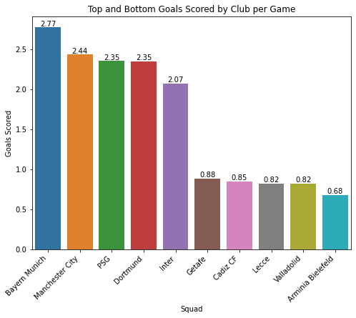
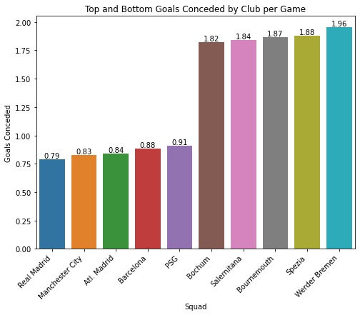
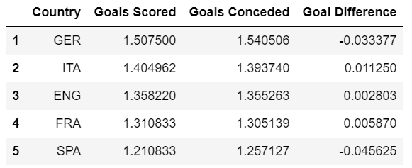
EDA (1) – Goals Scored & Conceded
Goals Scored and PPG: 0.84
Goals Conceded and PPG: -0.75
Weak negative correlation (-0.40) between goals scored and conceded
Need not sacrifice defence for attack
Notes:
Best clubs can attack and defend well
Here are the top 5 teams; here are the bottom 5
Goals scored has a higher absolute correlation than goals conceded → game state, once you score opponents have to attack you
For the fans, German Bundelesliga is highest-scoring and Spanish LaLiga is lowest (Italian Serie A used to be the best defensive league)

Slide 11
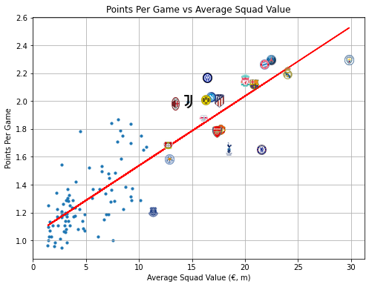
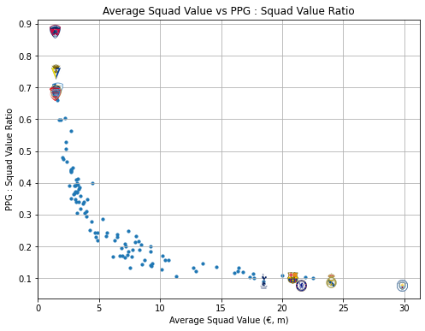
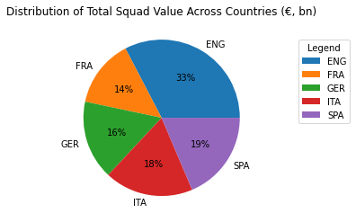
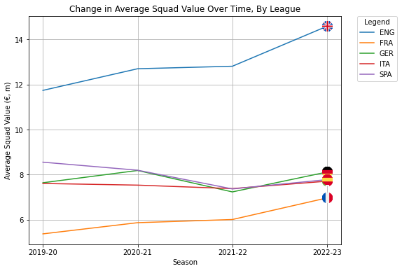
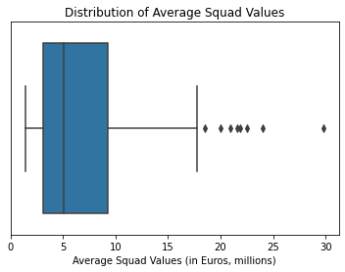
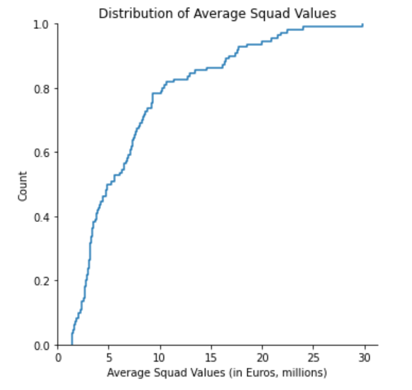
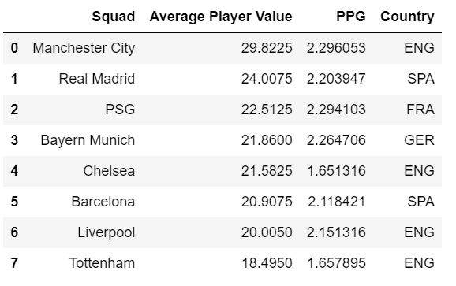
EDA (2) – Average Squad Value
Correlation between average Squad Value and PPG: 0.77
Outliers: a handful of extremely rich clubs owned by extremely wealthy countries/groups/individuals
England has significantly higher television broadcast revenue
Notes:
Saw this before as Lorenz curve to calculate Gini coefficient and income inequality; proportion of wealth mostly concentrated around the middle
Curvilinear negative correlation → diminishing marginal returns on points as spending increases

Slide 12
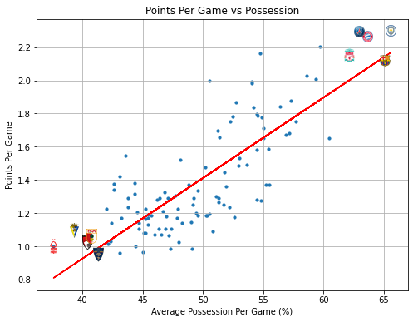
EDA (3) – Possession
Correlation between PPG and possession: 0.75
Considered more “exciting” and “attacking” football → fans of “bigger” expect their clubs like to play this way

Slide 13
EDA – Note
EDA vs ML
EDA: current season performance stats vs current season results
ML: previous season performance stats vs current season results
Using previous season stats, correlation with PPG is:
Average squad value → 0.66
Possession → 0.448408
Notes:
We use current in EDA because it’s more accurate; previous in ML because we have no choice
Squad value still strong because playing staff change less frequently; possession changes more because managers get sacked

Slide 14
03
Machine Learning
Aims
Model
Techniques
Notes:
Thank you Luke. Next, we will be moving on to Machine Learning.

Slide 15
Aim
Predict outcome of a match (Win, Lose, Draw) given the past performance data of each team and other information about the match.
Extra challenge: Predict the overall league standings for current 2023-24 season
Workflow:
Prepare data for models
Scale numeric data using StandardScaler() and encode categorical data using LabelEncoder()
Perform Feature Selection to choose the most relevant features
Supervised Learning: Train models on our training data and make predictions on test data
Evaluate metrics for each model
Predict results for this season
Print league standings for current 2023-24 season
Notes:
Our aim for machine learning models was to predict outcomes of each match, and the overall league standings for the current season, which includes games that have not been played yet. For the workflow: we scale and encode our data, then perform feature selection, before using supervised learning on various models to predict the match outcomes. we evaluate the models, and finally predict match outcomes for the current season this year.

Slide 16
Feature Selection
For Feature Selection, we used 3 main techniques to filter over 200 variables influencing a game to just 20+ variables:
Correlation: Filtering out variables that are strongly correlated; suggests that some of these variables are redundant
Logistic Regression: Filtering out variables that don't seem to contribute much to predicting the outcomes of a match
Importantly, we chose more features that had a stronger contribution to draws due to models’ inability to predict draws (explained later).
Boruta: We researched and found this algorithm online that could help to further discard unnecessary features.
Boruta is a heuristic variable selection algorithm based on the random forests algorithm that aims to find the most relevant variables in a dataset. (Rodrigues, 2022)
Notes:
For feature selection, we realised the problem of having over 250 features, many of which were highly correlated. As such, we implemented feature selection in 3 ways. First, we used correlation to filter out variables that were strongly correlated e.g. shots on target %, shots on target per 90, and only choosing to use one of them. Next, we used logistic regression and implemented the Boruta algorithm to further reduce the number of important features.

Slide 17
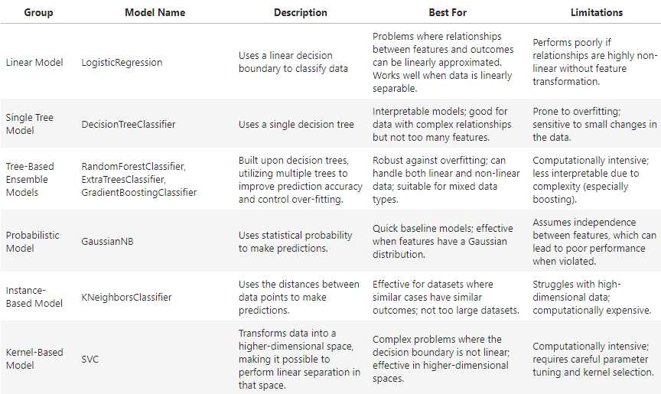
Machine Learning
Label: W
Type of problem: Classification
Models Used:
DecisionTreeClassifier
ExtraTreesClassifier
GaussianNB
GradientBoostingClassifier
KNeighborsClassifier
LogisticRegression
RandomForestClassifier
SVC
All models were trained on features that we had selected, to predict the labels 'W', 'L' or 'D', which are the match outcomes
Notes:
Generally, we wanted to work on a classification problem, Each row was a game, whose features comprised of the team1 and team 2’s performance from the previous season and other details of the game such as datetime, and these were used to predict whether the label would be ‘W’, ‘L’ or ‘D’, determined by comparing ‘score’ with ‘opponent_score’ → this allow us to decide on which team we should bet on to win.
After researching, we decide to use the these 8 classification algorithms in the table. We fit our data onto each of these models and trained them to predict our test dataset,

Slide 18
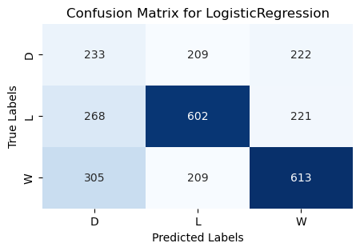
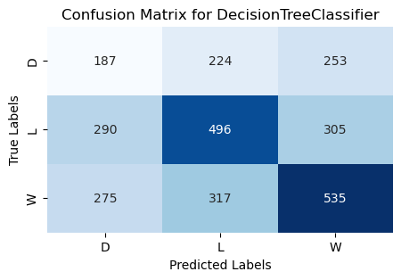
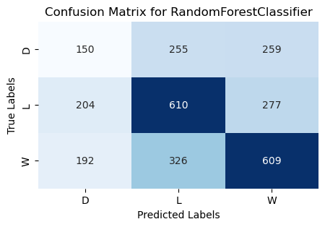
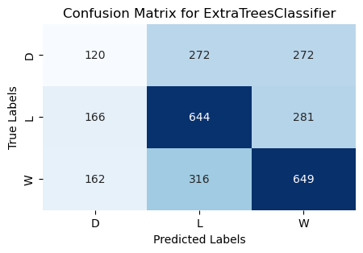
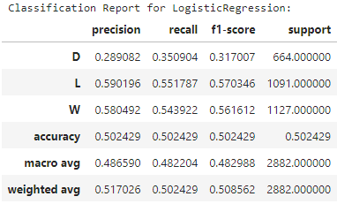
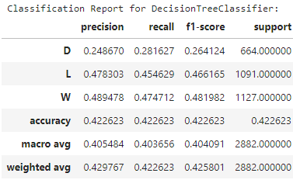
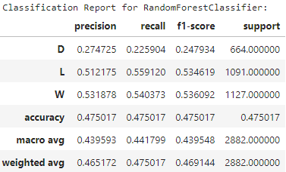
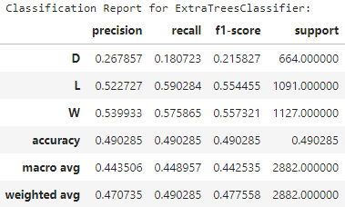
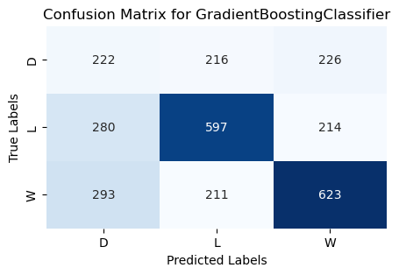
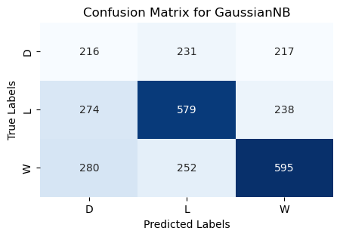
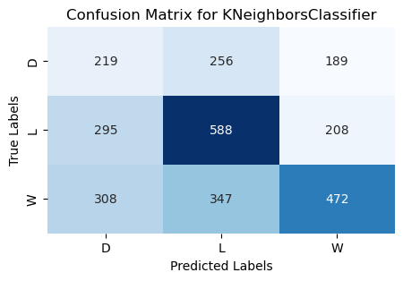
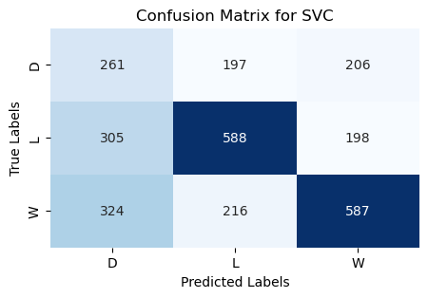
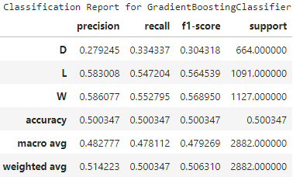
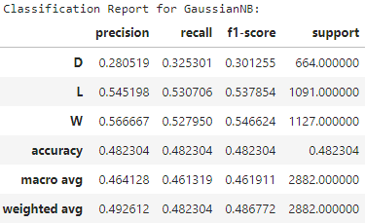
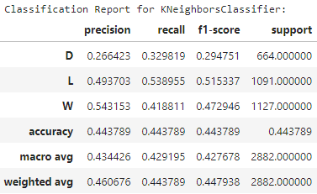
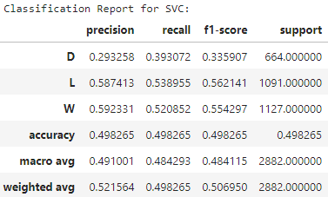
Notes:
and these are the results which we will evaluate later.

Slide 19
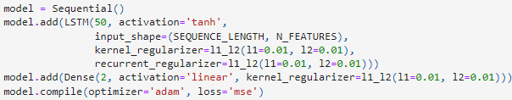
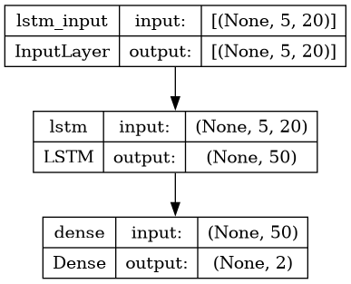
Deep Learning: LSTM
Type of problem: Regression
Motivation: “The players’ physical and psychological quality, the game tactics, weather factors and even some unexpected accidental factors will also affect the result of the game. Therefore, the linear prediction method cannot consider these factors, but the nonlinear method can.” (Zhang et al., 2022)
Tried to predict 2 numeric labels in the form of ['score', 'opponent_score’] to determine the outcome ['W', 'L', 'D’]. This required 2 Dense nodes on the output layer instead of 1.
Initially had a dropout layer but it badly affected the prediction of losses.
Notes:
However, in our research we found a team had used a LSTM model to approach this problem, because non-linear factors also affected the results of the game, and previous games are most likely going to affect the current game results. We transformed our dataset into sequences of five games per team, sorted by timestamps, for model training. Out of curiosity, instead of a classification approach, we opted for a regression model that predicts two numeric outputs—'score' and 'opponent_score’—, using two dense nodes instead of a softmax layer. We then categorize the outcome based on these predictions,.

Slide 20
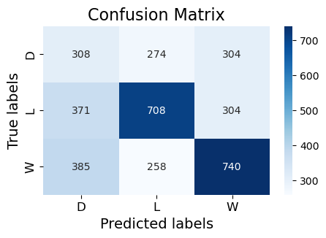
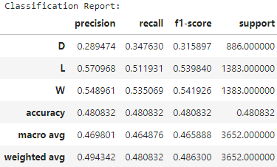
Notes:
We will now compare these models.

Slide 21
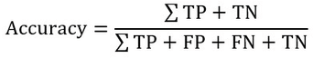
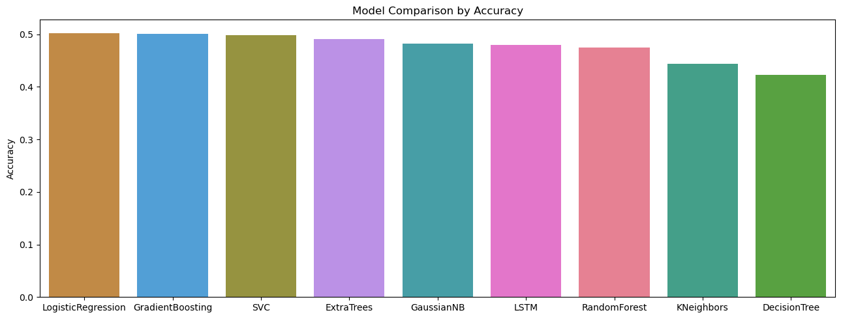
Results: Accuracy
Winner: LogisticRegression
Notes:
Due to time constraints, we will quickly move through these. Firstly, Based on Accuracy, LogisticRegression was best, Decision Tree worst;

Slide 22
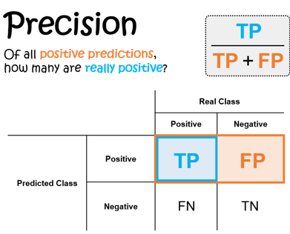
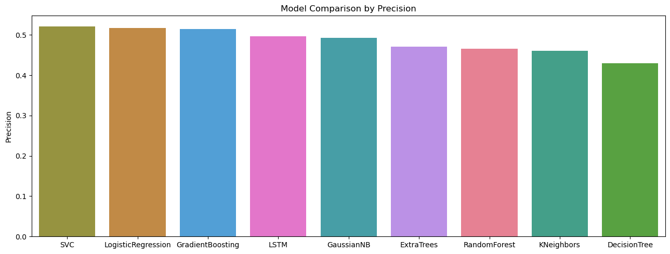
Results: Precision
Winner: SVC
Notes:
For precision, SVC came in first, LogisticRegression 2nd, and decision tree last.

Slide 23
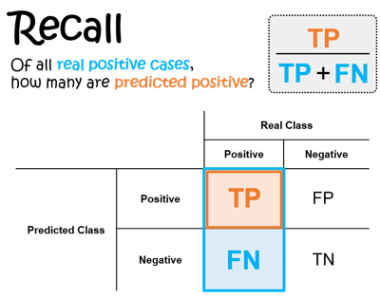
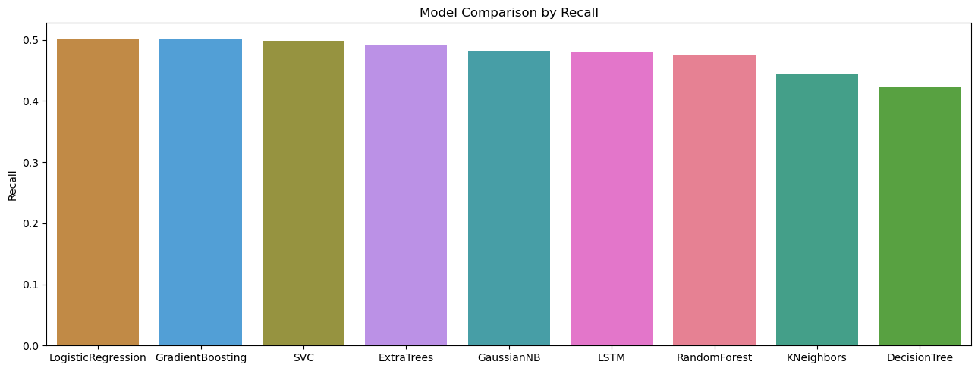
Results: Recall
Winner: LogisticRegression
Notes:
For Recall and F1 score, LogisticRegression once again won and DecisionTree last.

Slide 24
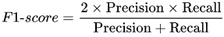
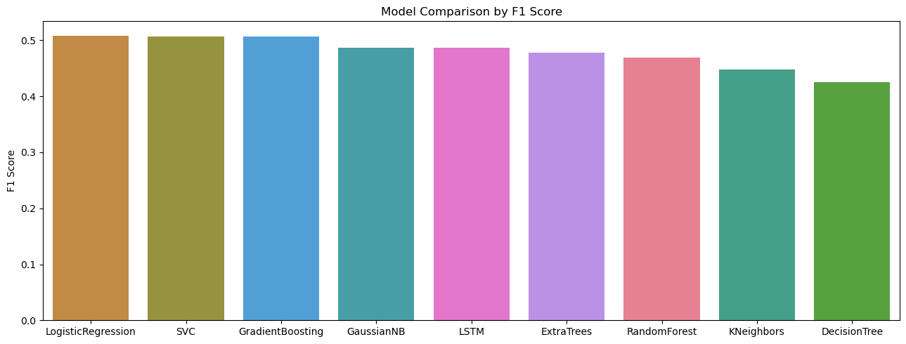
Results: F1 Score
The F1 score only becomes high when both precision and recall are high, indicating a balanced and effective model.
Winner: LogisticRegression

Slide 25
Model Evaluations
Best Models:
1. LogisticRegression
2. SVC
3. GradientBoosting
Worst Models:
1. DecisionTree
2. KNeighbours
3. RandomForest
LSTM, GaussianNB, and ExtraTrees had average performance
Notes:
Overall the strongest model was LogisticRegression. While the worst model was Decision Tree. Our deep learning LSTM model placed somewhere in the middle.

Slide 26
04
Conclusion
Outcome/Insights
Recommendations
Areas of Improvement
Notes:
So moving onto the conclusion, here is what we have found.

Slide 27
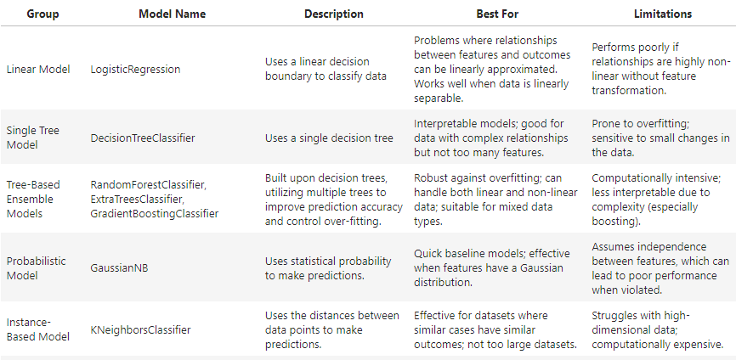
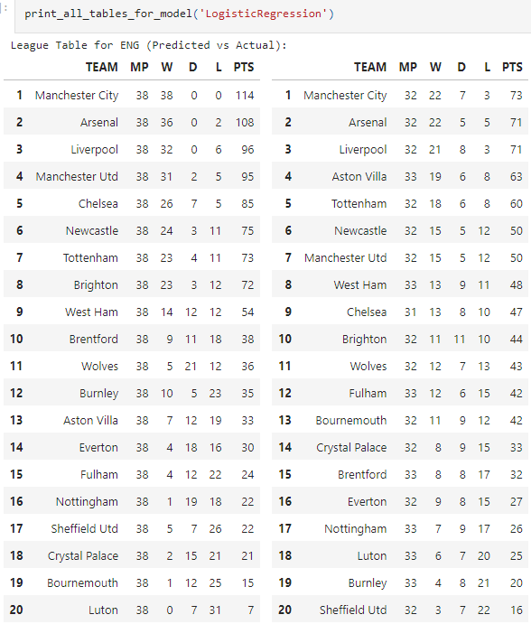
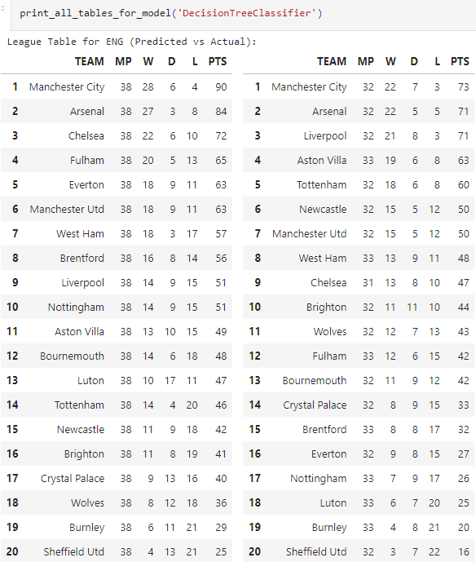
Best vs Worst Model
The best model was LogisticRegression, while the worst model was DecisionTree. However, Decision Tree results seems more realistic than Logistic Regression.
How does the data show that DecisionTree actually performed poorly?
Notes:
Firstly, an interesting observation is that LogisticRegression while being the best model actually fails to predict draws for the strongest teams, unlike DecisionTree, which is the worst model. But when analyzing the data <CLICK> we note how predictions for current league standings of certain teams are a lot worse than LogisticRegression. <CLICK> It also seems to prove the point that the 2 worst models DecisionTree and K-neighbours do not perform well when there are too many features.

Slide 28


Draws are extremely difficult to predict
Especially difficult at the top level
Even after using:
Logistic Regression to favor feature selection for draws compared to wins and losses
balanced sample weight when fitting data onto models
Models still perform poorly in predicting draws
→ Draws involve more uncertainty and variability
→ Features not sensitive to the nuances that lead to draws
Solutions: Principle Component Analysis?
Notes:
This also suggests that draws are extremely difficult to predict especially for top teams, and this is actually the case across our top 3 models.. Even after using various techniques to improve draw prediction, the models still performed poorly on precision of draws, across all models. Perhaps, a solution would be to use PCA for feature engineering

Slide 29

What do the better models ie. Logistic Regression, SVC and Gradient Boosting tell us? (1)
Wins and losses have a more substantial impact than draws in the accuracy of the predictive models.
Notes:
As such, this tells us that wins and losses have a more substantial impact than draws in the accuracy of the predictive models. A model can do very well in predicting wins and losses and do badly in predicting draws, but it can still perform better than models that attempt to categorise draws.

Slide 30

What do the better models ie. Logistic Regression, SVC and Gradient Boosting tell us? (2)
2. GradientBoosting (a Tree Ensemble algorithm) is the 3rd best model, performing better than a single Decision Tree.
Notes:
Furthermore, it also shows how tree based-ensemble methods like the Gradient Boosting Classifier, that takes into account more than 1 decision tree, is better at controlling overfitting, and improve accuracy compared to the single decision tree that performed poorly.

Slide 31

What does the models tell us about the nature of the data?
It seems that our data is linear, rather than non-linear.
Data for each team performance for every game is the same throughout the season, so LSTM does not capture any significant patterns within the sequences
Solution: Get more detailed data for each game → non-linear data such as weather etc..
Notes:
Next we note how the logistic regression, which is a linear model, did much better than the LSTM model which we implemented to try to capture patterns in non-linear data features. it suggests that our features are more linear than it is non-linear. This is supported because our data for each team performance for every game is the same throughout the season, because it is the average performance from the previous season. Moreover, we do not actually have non-linear data such as weather, which can cause the LSTM to be less effective in capturing patterns within sequences.

Slide 32

Using previous season performance data is not a very good indicator for current results
Changes occuring during the transition from one season to the next are not being considered.
Results are often unpredictable.
1. Leicester City in 2015-16, pre-season odds of 5000:1.
2. Bayer Leverkusen in 2023-24, pre-season odds of 50:1.
Notes:
Lastly, it seems that using previous season performance data is not a very good indicator for current results. This is intuitive, as teams will undergo many changes during the transitions between seasons, hence using previous season performance does not consider the new capabilities of the team going into the season. Results have also proven to be unpredictable from the past, such as Bayer Leverkusen's win this season after Bayern Munich won the league for the past 11 years.

Slide 33

Did we solve the problem?
Accuracy of Logistic Regression = 0.5024
Baseline Accuracy - the accuracy that a naive model would achieve if it always predicted the most frequent class (outcome):
$$\frac{Most common outcome (wins)}{Total number of games}= \frac{305+209+613}{2882}=0.391$$
Performs better than a naive approach that always predicts the most common outcome.
However, its performance might still not be sufficiently high to guarantee a profitable betting strategy.
The key to profitability is to successfully identify when the probability of an event occurring is greater than what the bookmakers’ odds suggest.
Notes:
When considering whether we have succeeded in generating a model to bet on scores, the Logistic Regression model has an accuracy of around 0.5 is greater than the baseline accuracy. However, the accuracy of around 0.5 means that we will only be correct half the time, which is poor since profitability is also affected by the odds provided by bookmakers. What we need is to successfully identify when the probability of an outcome occurring is greater than what the odds suggest. However, if it only does well on low-odds bets - in situations where the outcome is obvious because one team is clearly stronger than the other and misses on high-odds bets – in situations where the outcome is less certain because teams are more evenly matched, the wins on low-value bets are unlikely to offset the losses from the incorrect high-value bets. As such, while our model does seem to provide value in betting on football scores, we are most likely still unprofitable and further optimization is required before it can be truly profitable.

Slide 34
References
balpino. (2021, May 29). Ivan Toney Brentford GIF. Tenor. https://tenor.com/en-GB/view/ivan-toney-brentford-toneygoat-ivanparty-ivan-toney-brentford-gif-21744403
Futball_Karim. (2022, April 3). Sandro Tonali Tonali Clapping GIF. Tenor. https://tenor.com/en-GB/view/sandro-tonali-tonali-clapping-tonali-tonali-milan-st8-gif-25040629
Hassan, F. (2023, March 25). Beautiful Soup: A Python Library for Web Scraping - Dev Genius. Medium. https://blog.devgenius.io/introduction-to-beautiful-soup-a-python-library-for-web-scraping-21cacb9cf088
Patil, P. (2023, May 3). How to use Playwright For Web Scraping with Python. https://www.linkedin.com/pulse/how-use-playwright-web-scraping-python-prashant-patil
Zhang, Q., Zhang, X., Hu, H., Li, C., Lin, Y., & Ma, R. (2022). Sports match prediction model for training and exercise using attention-based LSTM network. Digital Communications and Networks, 8(4), 508-515. https://www.sciencedirect.com/science/article/pii/S2352864821000602
Rodrigues, F., & Pinto, Â. (2022). Prediction of football match results with Machine Learning. Procedia Computer Science, 204, 463-470. https://www.sciencedirect.com/science/article/pii/S1877050922007955

Slide 35
Thank you!

